Slide 1
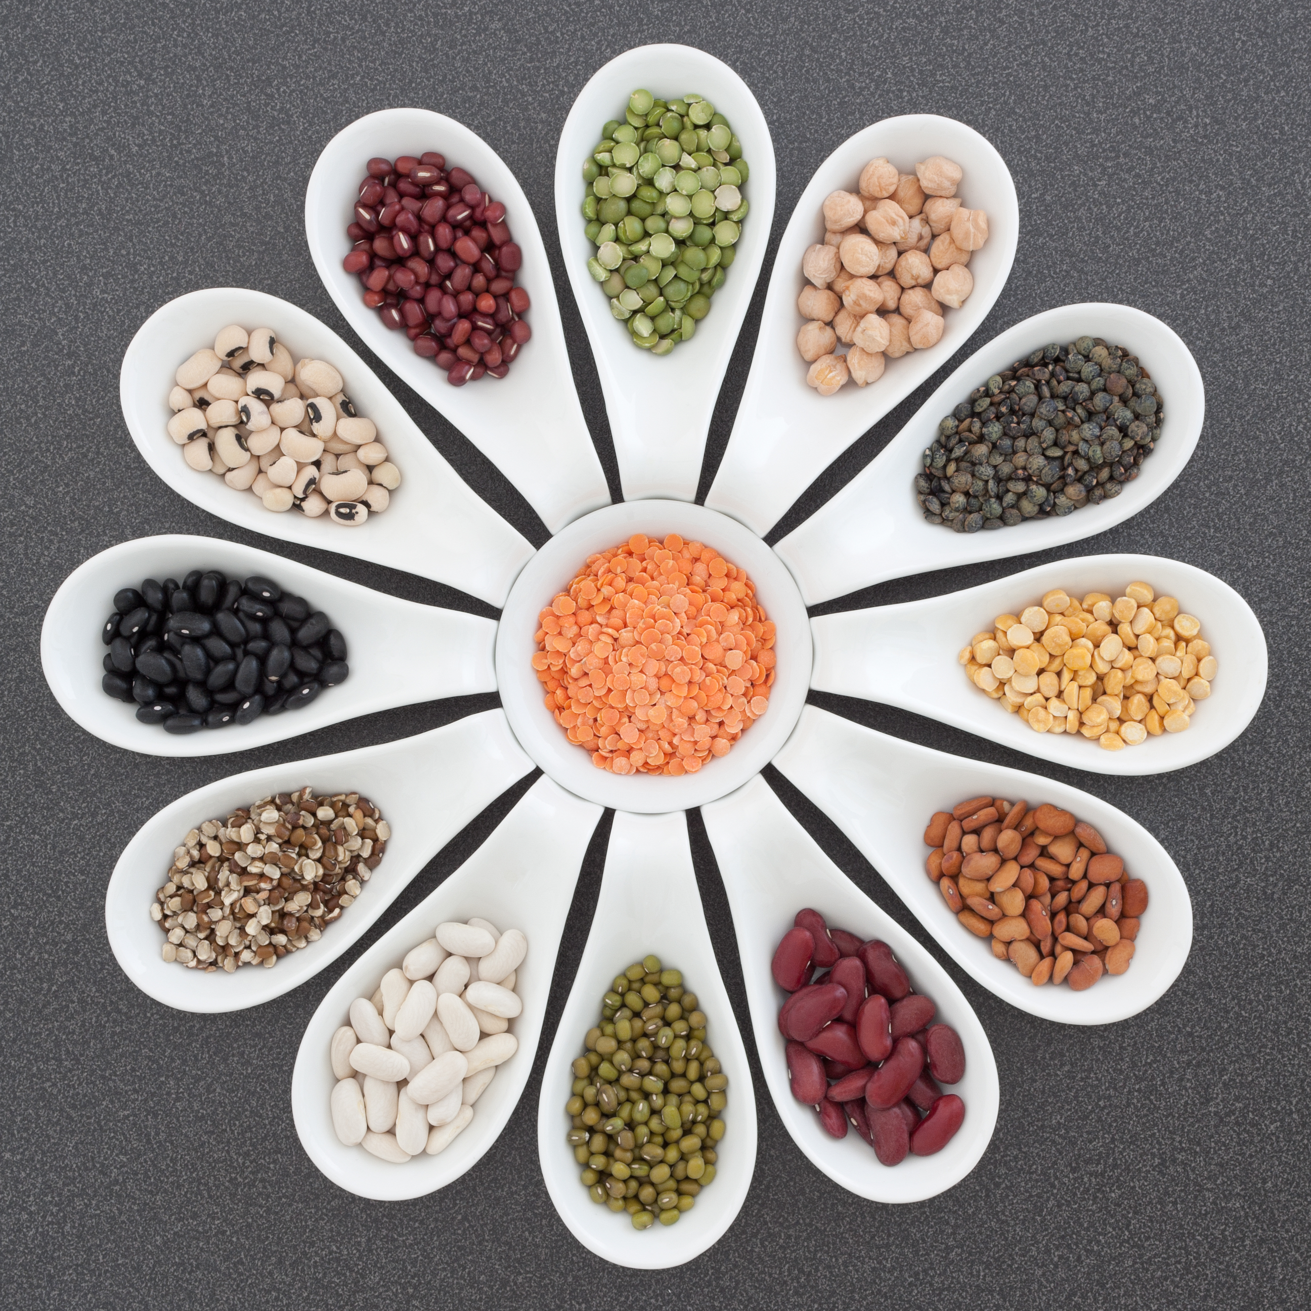
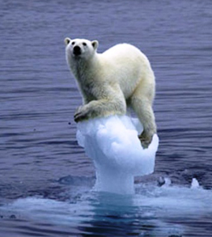
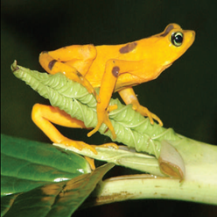
Foodprint
Connections between food and the environment
Impacts of Livestock on Biodiversity
Biodiversity Loss and the Planetary Boundaries
Livestock’s role in major drivers of biodiversity loss: habitat change and climate change
Activity—Communicating biodiversity loss

Slide 2
In the 2009 Planetary Boundaries, we were already exceeding global sustainability limits for climate change, nitrogen cycling, and biodiversity loss.
Source: Rockstrom et al, Nature, 2009

Slide 3
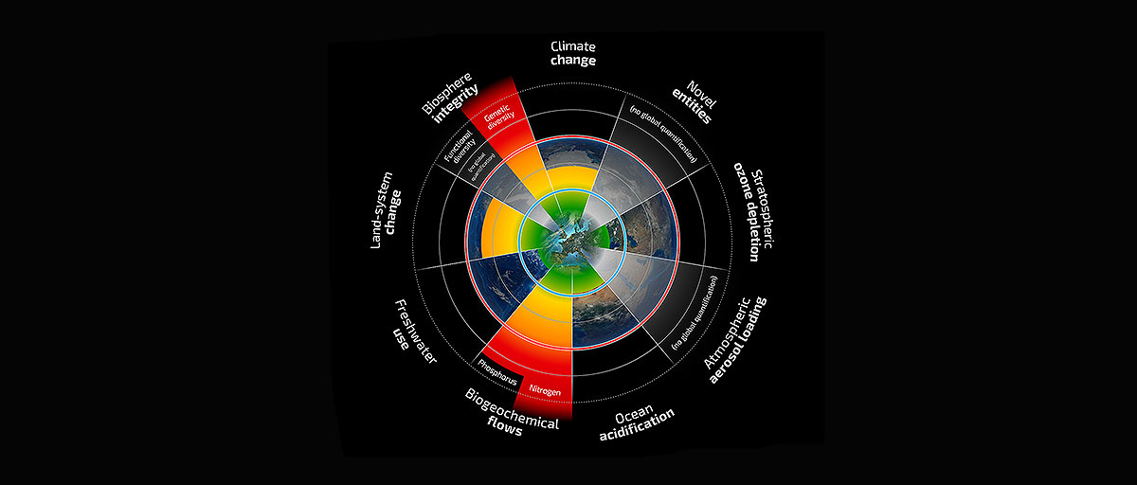
Planetary Boundaries: A Safe Operating Space for Humanity
By 2015, we were exceeding PB’s for climate change, nitrogen and phosphorus cycling, land use change, and biodiversity loss.
Source: Steffen et al. 2015

Slide 4
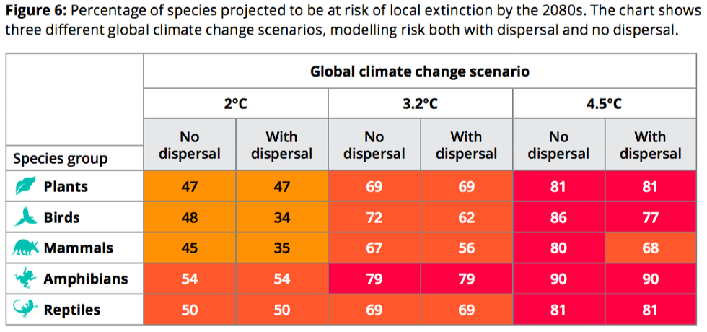
Source: EcoWatch

Slide 5
Major Biodiversity Loss Drivers
Habitat change
Climate change
Pollution
Invasive species
Overexploitation

Slide 6
Major Biodiversity Loss Drivers
Habitat Change
Climate Change
Overexploitation
Pollution
Invasive species

Slide 7
Major Biodiversity Loss Drivers
Habitat Change
Climate Change
Food systems
Overexploitation
Pollution
Invasive species

Slide 8
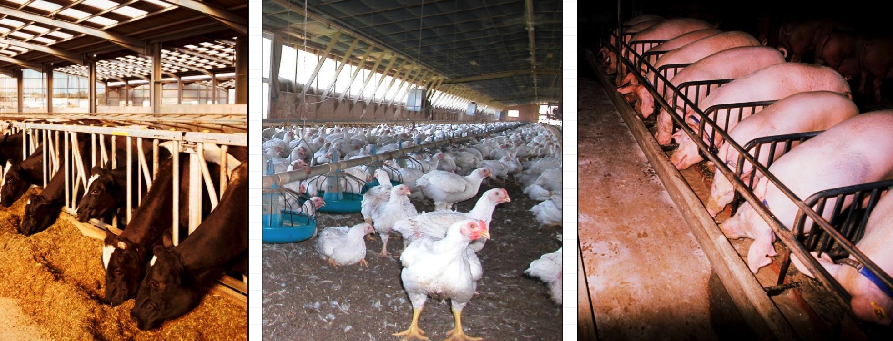
Livestock plays a major role in biodiversity loss:
Habitat change
Climate change
Pollution
Invasive species
Overexploitation

Slide 9
What is livestock’s role in biodiversity loss
Habitat change
Climate change
Invasive species
Overexploitation
Pollution

Slide 10
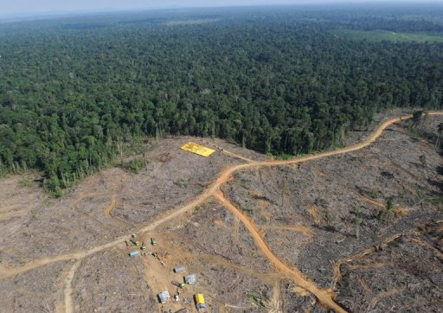
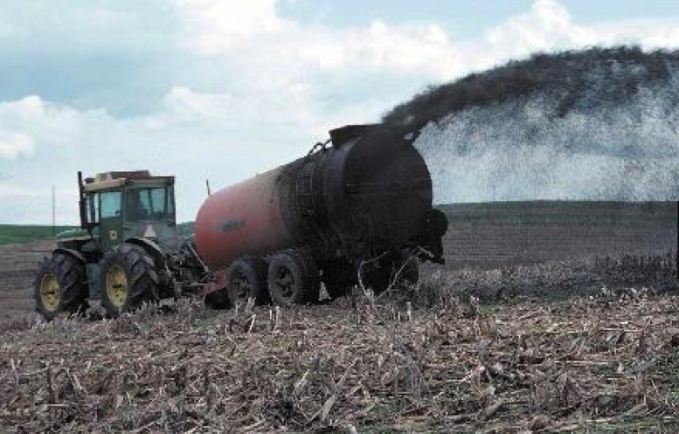
Livestock’s role in habitat change
Much of the land surface of the Earth is used for agriculture.
U.N.: Livestock production accounts for 70% of all agricultural land and 30% of the land surface of the planet.

Slide 11
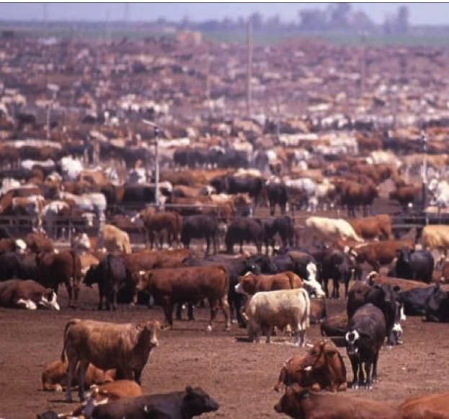
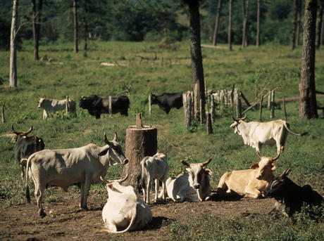
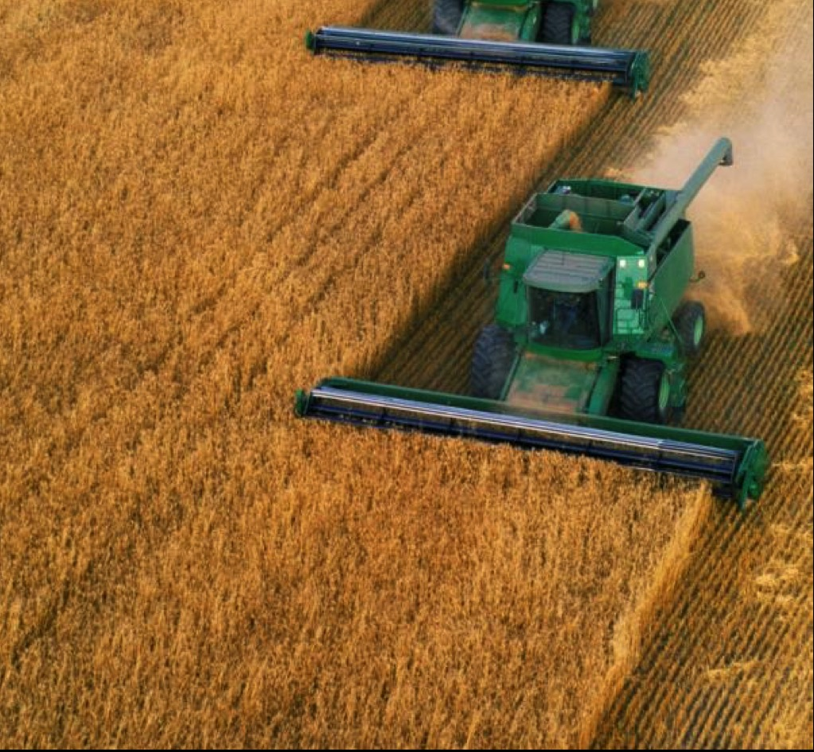
Livestock’s role in habitat change
Habitat destruction, fragmentation, and degradation are the major threat to biodiversity on a global scale.
Livestock are a direct and dominant cause of habitat change, due to:
Overgrazing can degrade land
Livestock land
Feed crop production

Slide 12
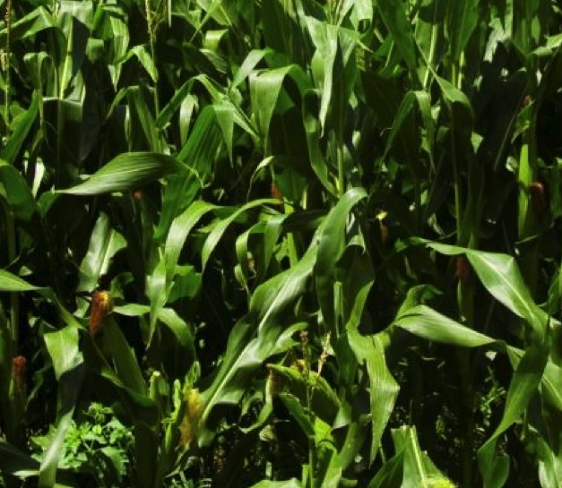
There is much deforestation due to livestock production occurring in Latin America
Cattle grazing on former forests
Expansion occurring in diffuse matter, fragmenting landscape
An increasing share of the region’s cropland goes to animal feed (soybeans and corn)

Slide 13
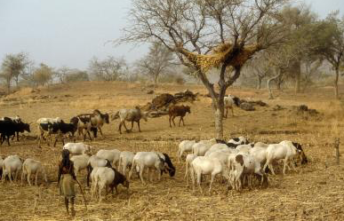
Rangeland degradation occurs if livestock density exceeds capacity of pasture.

Slide 14
A) China data shown
B) Land for production
C) Land increase needed to meet projected demand
(% of current ag land)

Slide 15
How is this additional land being obtained?
Case study: China
Due to changes in diet and increasing population density, impacts on biodiversity loss will extend far beyond the borders
Diet was 5% animal products in 1960. Currently the diet is approx. 20%, and it is projected to reach 30% in 20 yrs.
Despite rising consumption, agricultural land has decreased due to urbanization and land degradation (90% of China’s grasslands considered degraded.)

Slide 16
How is this additional land being obtained?
Land grabbing!
This is the transfer of rights to land from local communities to foreign investors, mainly for agriculture.
Already, much livestock in China is fed soy from the Amazon. Currently 40,000 km² (15,444 mi²) of Brazilian cropland is for China’s livestock
RI is 1,212 mi!! CT is 5,543 mi², MA is 10,565 mi²

Slide 17
How is this additional land being obtained?
Land grabbing!
Since 2008, the World Bank has estimated that 174,000 mi² has been acquired by foreign investors.
Grabbed land is typically in developing tropical countries and can add up to a large fraction of the total land area.
20% of Uruguay, 17% of Philippines, 7% of Sierra Leone

Slide 18
What is livestock’s role in biodiversity loss
Habitat change
Climate change
Pollution
Invasive species
Overexploitation

Slide 19
Carbon footprint of our Food
Foods vary in the amount of greenhouse gas emissions embodied in their production.
Source for data: Heller and Keoleian, 2014 and USDA Food Composition Database
Notes:
Foods vary in the amount of greenhouse gas emissions embodied in their production.
This table shows the carbon footprint of a list of different food items. You can see here that beef and lamb are at the bottom of the chart.
Why is that?
Whenever we grow crops for livestock feed rather than direct consumption, there is a multiplier there, which takes into account food production, transportation of the feed, and conversion efficiency of the feed by the animal. But also, for ruminant animals, like cows, sheep and goats, methane is produced as part of the natural metabolism.
Methane is a more powerful GHG than CO2, so it contributes greater warming potential per molecule.

Slide 21
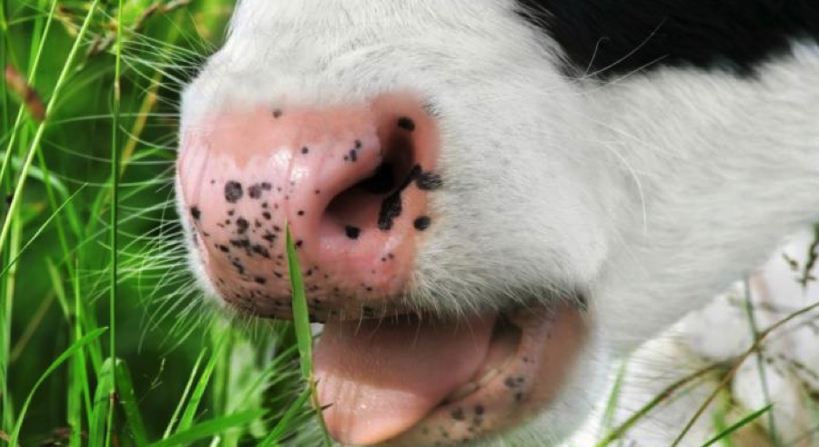
Even pasture-raised cattle release high levels of greenhouse gases through belching methane

Slide 22
Think-Pair-Share
What are some of the most critical facts/concepts in the Machovina article?

Slide 23
Highlights from Machovina et al.
“Livestock is the single largest driver of habitat loss.”
“Both livestock and feedstock production are increasing in developing tropical countries where the majority of biological diversity resides.”
“The projected land base required by 2050 to support livestock production in several megadiverse countries exceeds 30–50% of their current agricultural areas.”
“Livestock production is also a leading cause of climate change, soil loss, water and nutrient pollution, and decreases of apex predators and wild herbivores, compounding pressures on ecosys- tems and biodiversity.”

Slide 24
Highlights from Machovina et al.
“…livestock production, including feed production, accounts for approximately three-quarters of all agricultural land and nearly one-third of the ice-free land surface of the planet, making it the single largest anthropogenic land use type (Steinfeld et al., 2006a).”
livestock production “is likely the leading cause of modern species extinctions, since it is not only the major driver of deforestation but also a principle driver of land degradation, pollution, climate change, overfishing, sedimentation of coastal areas, facilitation of invasions by alien species, (Steinfeld et al., 2006a) and loss of wild carnivores (Ripple et al., 2014a) and wild herbivores (Ripple et al., 2015)”

Slide 25
Highlights from Machovina et al.
“Over three- quarters of all deforested lands in the region have been converted to livestock pasture and feedcrop production for domestic and international markets (Nepstad et al., 2006; Nepstad et al., 2008; Walker et al., 2009).”
“Rising worldwide demands for meat, feedcrops, and biofuel are driving rapid agro-industrial expansion into Amazon forest regions (Nepstad et al., 2008).”
“Feedcrop production as well as pasture is projected to continue expanding in the Amazon (Masuda and Goldsmith, 2009).”

Slide 26
Highlights from Machovina et al.
“Across global ecosystems, twenty-five biodiversity hotspots have been identified (Myers et al., 2000) that collectively contain as endemics approximately 44% of the world's plants and 35% of terrestrial vertebrates in an area that formerly covered only about 12% of the land surface of the planet. Due to human activities, the total extent of these hotspots has been reduced by nearly 90% of the original size — meaning that this wealth of biodiversity is now restricted to only b2% of Earth's land surface (Myers et al., 2000).

Slide 27
Highlights from Machovina et al.
“Given current trends, the extent of land area converted to agriculture to meet growing global food demands is predicted to increase by approximately 18% from 2000 to 2050. This equates to a loss of 1,000,000,000 ha of natural habitats — an area larger than the USA (Tilman et al. 2001)

Slide 28
Infographic Activity
Use the Powerpoint slides as templates, or just sketch, an infographic that will convey one of the concepts in today’s class that is most moving to you.
In the notes section, please write a caption that could be used for a blog or Instagram post.
Include all of the members of your group by name.
Indicate if you would be interested in having a version of your Infographic posted on meals4planet.org and/or the @meals4planet Instagram feed.
Eat for the Planet @eftp.co has a lot of great infographics.

Slide 29

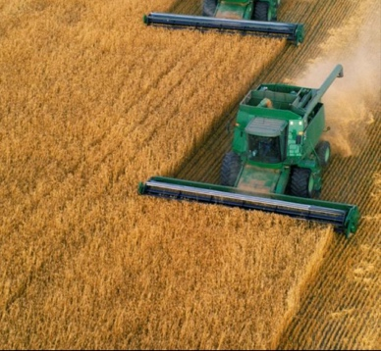
Living in proximity to livestock and manured fields is associated with:
Increased:
Exposure to antibiotic-resistant pathogens including MRSA
Skin infection
Soft tissue infections
Exacerbation of COPD
Selected sources: Casey et al., 2013; van Dijk et al. 2016; Carrel et al., 2014; Bisdorff et al. 2012; and Feingold et al. 2012.
@meals4planet, meals4planet.org
Notes:
After visiting the new Beyond Meat location in El Segundo yesterday, I was inspired to make this super easy and delicious lunch. I just heated Beyond Meat Crumbles and some Annie’s BBQ sauce in a skillet—super easy and delicious! The difference in carbon footprint arises from the feed that is fed to cattle--which requires nitrogen fertilizer—a greenhouse gas intensive product--and the methane produced by cattle.
For the calculations, I used the Heller and Keoleian (2014) review paper emissions data for the beef, bun, onion, and tomato. For the crumbles (which are not quantified in Heller and Keoleian), I used the average of the values reported in Nijdam et al.(2012) for meat substitutes. There will soon be a detailed life cycle analysis on Beyond Meat specifically, and I can update the calculation then.

Slide 30
Some varieties of chocolate are currently threatened by climate change!
Why buy Fair Trade?
Environmental Sustainability
Justice for farmers

Slide 31
What do the circles look like to you?

